Slide 1

Architecture final
Cameron, Julia, jude, katherine

Slide 2
goalS
Original Goals
List Processor: Implemented
General Processor: Implemented
N-Body Simulation : Not implemented
Accomplishments:
Modified List Processor
General Processor with modified instruction set
Simple game – close to working

Slide 3
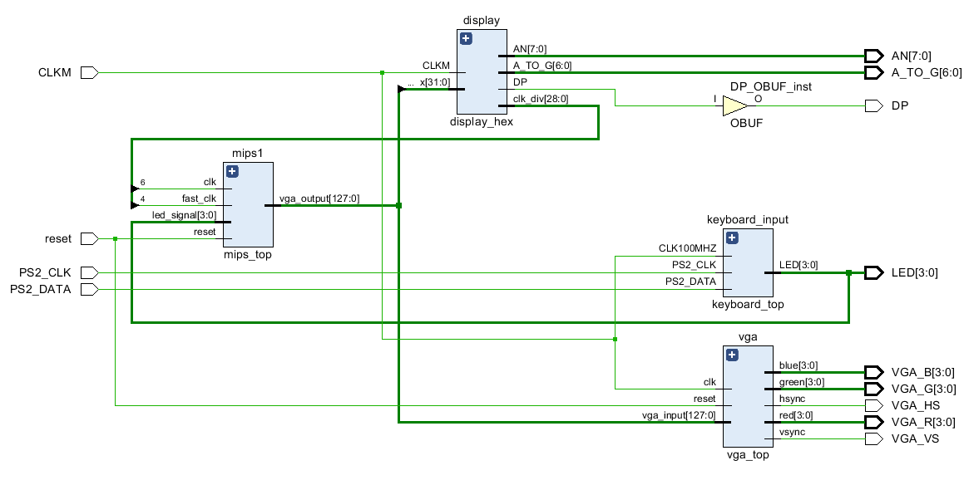
I/O

Slide 4
I/O
Input:
Keyboard
Arrow keys change the direction of the drawn item
Output:
7 Segment Display
Demonstrated the y coordinate changing
LEDs
Shows the current keyboard input
VGA
The position of the item is changed every cycle and this is reflected on the screen

Slide 5

Program Demo

Slide 6
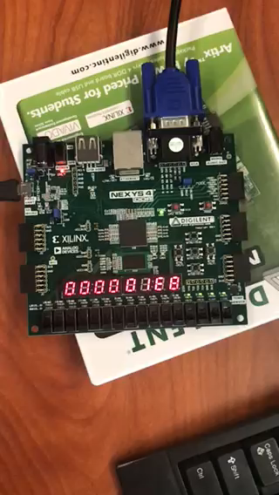

Slide 7
challenges
Challenges
Successes
Interfacing successfully with the keyboard
Debugging a real time application that uses waits
Differences between simulation and implementation
Overcame many difficulties
Squashed many bugs
Learnt a lot of lessons about Vivado + VHDL

Slide 8
Final thoughts
Difficulty can be hard to gauge
Design changes over time
This project has been about the journey, not necessarily the destination
Pair programming is amazing
Creating a working microprocessor is difficult
It pays to seriously think about one’s compiler

Slide 9

Thank You
<chinchilla here>

